Slide 1



Project Short Summary
The Market Sales Analysis project aims to analyze sales data to identify trends, patterns, and insights that can improve business decisions and sales performance. It involves collecting and cleaning sales data, using data analytics and machine learning to understand sales dynamics and predict future trends, and visualizing these findings with dashboards and reports. By doing this, the project helps the company better understand market trends, optimize sales strategies, and identify new opportunities for growth, Better understanding of market trends and customer-preferences,Data-driven optimization of sales strategies, Accurate sales forecasts and informed business decisions & Identification of new market opportunities.
Market Sales Analysis
Add Your Professional Profile Photo Here
Program Feedback
I had a very positive experience, got to learn about AI, ML, data analytics, cloud computing integrating with various algorithm and process on various types of data sets. Got to learn about the various features of IBM cloud and using those features to make chatbot and deploying it on various platforms. The teachers were very experienced and were very helpful through out the complete program. Their way of teaching was exceptional covering every minute topics and details of the topics that had been covered through out the program session.
SANJAY PRAMANIK
0231dcsai301@niet.co.in
Noida Institute of Engineering & Technology
(NIET) Gr.Noida
#skillsbuild

Slide 2
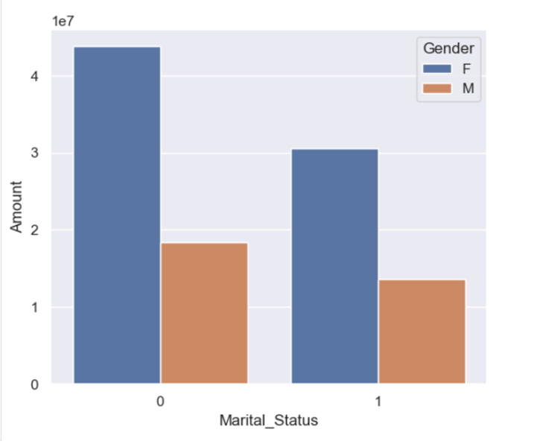
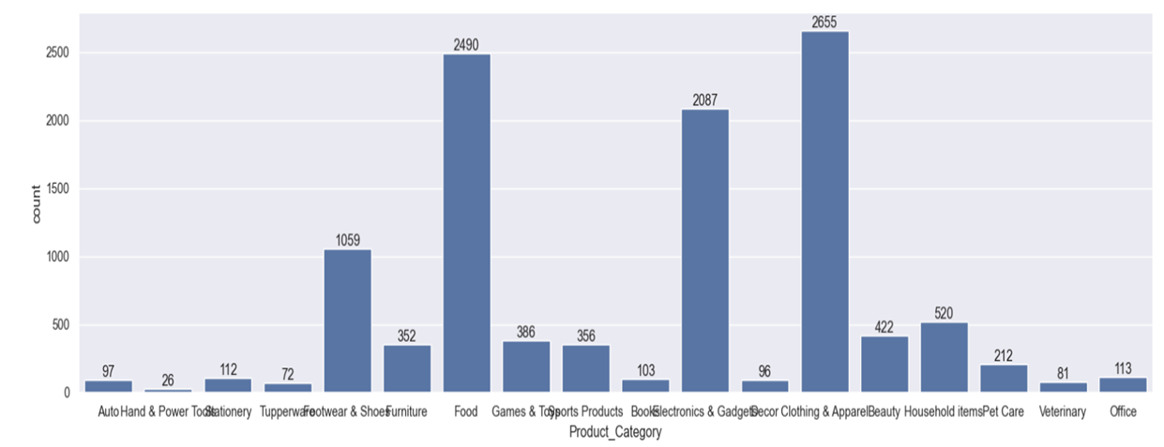
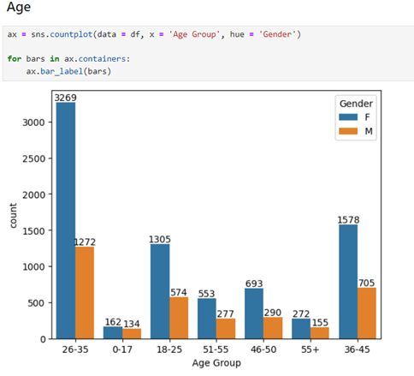
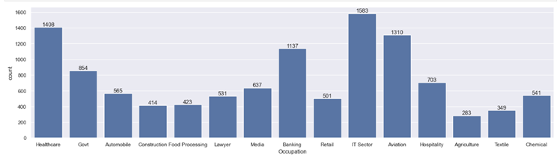
FINAL PROJECT OUTCOME SCREENSHOTS

